Slide 1


NEURAL STYLE TRANSFER FOR TEXT AND CHATS
Mentors:
Abhinav Raghuvanshi
Siddhesh Pawar
Mentees:
Amruta Parulekar
Sanika Padegaonkar
Ritesh Bahl

Slide 2

MOTIVATION
In the modern world, humans often use informal language, especially while texting.
Our team wanted to build a model, that would convert modern language to formal, Shakespearean language and further use it to have conversations with a chatbot.
For this, we used a pipeline-based approach for Neural Text-Style-Transfer to build a Shakespearean Paraphraser.
We used the HuggingFace Transformers Library and LSTM RNNS to achieve this.

Slide 3
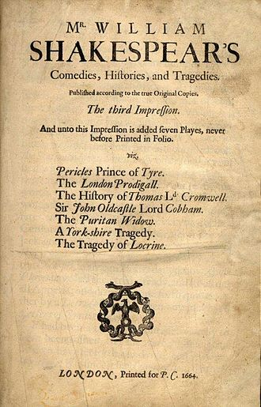
RESPONSIVE MODEL
We used the DialoGPT model to generate conversational responses to the output of our Shakespeaerean paraphraser.
DialoGPT is a large, tunable neural conversational response generation model, trained on 147M conversation-like exchanges extracted from Reddit comment chains over a period spanning from 2005 through 2017.

Slide 4

CHATBOT
The output of our Shakespearean Paraphraser was sent to a chatbot.
We developed a user interface for the chatbot.
The chatbot uses the responsive model to have a normal conversation with us.

Slide 5
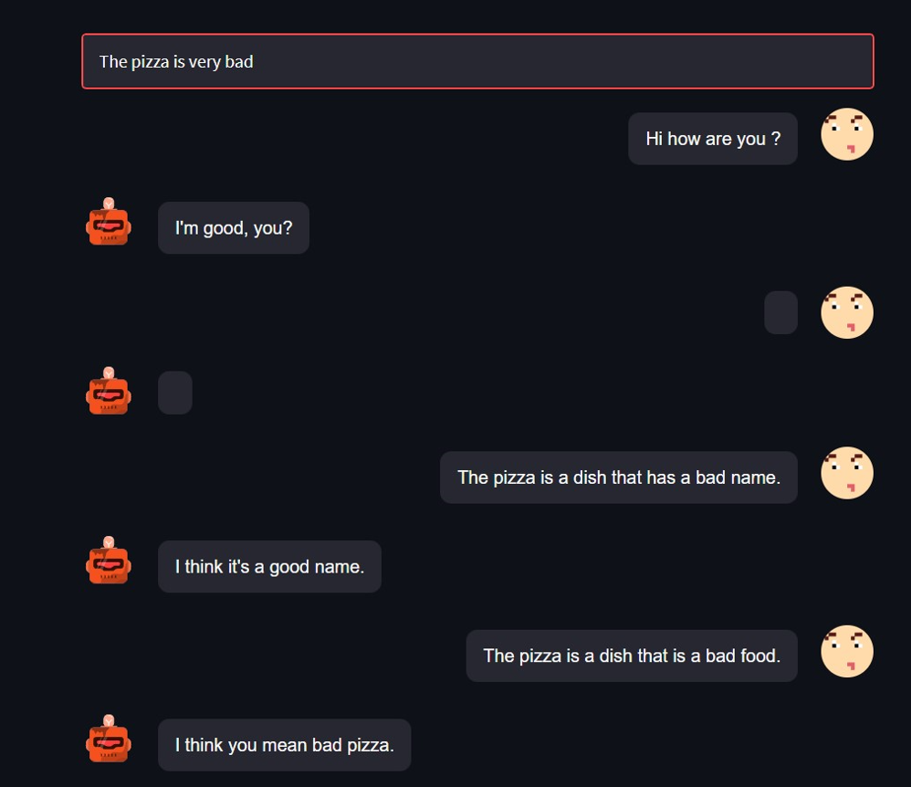
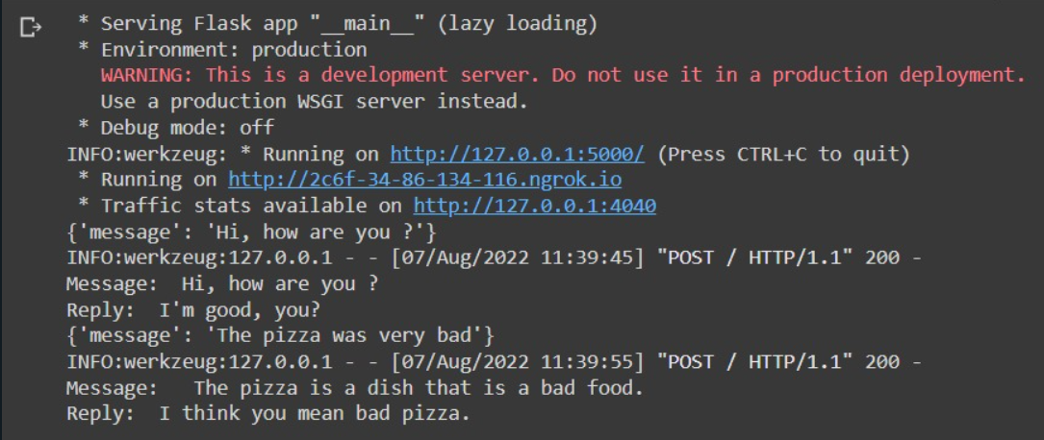
CHATBOT USER INTERFACE

Slide 6
HOW THE MODEL OPERATES
Parts Of Speech tagging in the input sentence
Finding the most similar sentence from the dataset
Generative Model

Slide 7

POS TAGGING
The overall sentiment of a sentence is generally determined by the adjectives used in it.
We have used the POS Tagger provided by nltk to identify the adjectives in the input sentence.
A part-of-speech tagger, or POS-tagger, processes a sequence of words, and attaches a part of speech tag to each word.

Slide 8

SENTENCE SIMILARITY
We now want to find the sentence in our dataset which is closest to our input sentence.
For this purpose, we use cosine similarity.
Cosine similarity measures the similarity between two vectors of an inner product space.
It is measured by the cosine of the angle between two vectors and determines whether two vectors are pointing in roughly the same direction.
To measure the cosine similarity, we encode our input sentence to produce an input vector.
Similarly, the sentences in our dataset are also encoded to produce vectors.

Slide 9

GENERATIVE MODEL
The adjectives in our input sentence are replaced with the adjectives in the sentence from our dataset and this new result is sent to a generative model.
This model generates a coherent output sentence that carries the same sentiment as our input sentence but with better phrasing.
We can see this output in our chat window.
This output is then sent to our conversational chatbot which responds accordingly.

Slide 10

FUTURE WORK
In this model, we used replacement of informal adjectives with formal adjectives for style transfer.
In the future, we aim to use attention weights, for better results.
We also aim to improve the user interface of the chatbot.

Slide 11
CONCLUSION
Thus, we have successfully created a Neural Style Transfer model that converts modern English statements to formal, Shakespearean language.
We have also integrated our Shakespearean Paraphraser with a chatbot.
We are excited to research on this model and improve it further.
THANK
YOU

Slide 12
REFERENCES
DialoGPT: https://arxiv.org/abs/1911.00536
Paper Implemented: https://medium.com/agara-labs/the-generative-style-transformer-3564bce04d04
The Hugging Face course on Transformers: https://huggingface.co/course/chapter0/1?fw=pt
https://medium.com/@mukundan_8066/author-style-transfer-using-recurrent-neural-networks-c8c8f83b33cc
https://direct.mit.edu/coli/article/doi/10.1162/coli_a_00426/108845/Deep-Learning-for-Text-Style-Transfer-A-Survey
https://datachef.co/blog/neural-language-style-transfer-with-wordmentor/
https://datachef.co/blog/paraphrasing-with-gpt2/
https://github.com/fuzhenxin/Style-Transfer-in-Text
https://github.com/topics/text-style-transfer
https://github.com/PrithivirajDamodaran/Styleformer
https://www.guru99.com/pos-tagging-chunking-nltk.html
https://aclanthology.org/D19-1322/

Slide 13
PRESENTATION

